Slide 1


Exploring the Snake Game in Python Turtle
This presentation dives into the development of the Snake Game using Turtle graphics in Python, covering programming concepts, educational value, and potential future applications.
Shradha Jadhav

Slide 2
Content
Introduction
Domain
Technology
Project Overview
Solution Architecture
Each Module / Component of the Solution
Demo - Solution
Future Expansion / Application
Conclusion
Thank & Contact
Q&A

Slide 3
Introduction
The snake game is a timeless classic that has been a part of gaming culture for decades. This project recreates the turtle library showcasing how simple tools can be utilized to build interactive and engaging applications game using python’s library. The goal of the project is to develop a fully functional snake game where the player controls the snake to eat food, grow in size, and avoid collisions, all while enjoying seamless graphics and responsive gameplay. This project highlights the versatility of python in game development and serves as an excellent way to understand the fundamentals of programming and graphical design.

Slide 4
Introduction
Domain : 1. Gaming and Application Development. 2. The project belongs to the domain of casual gaming, focusing on logic-based 2D games. 3. It highlights Python’s capability to create interactive and visually appealing games.

Slide 5
Introduction
Technology : Programming Language: Python Library/Framework Used: Turtle Why Turtle? Built-in Python library for creating simple 2D graphics. User-friendly, making it ideal for beginners. Suitable for learning graphical programming concepts. Other Tools Used: Python IDE (VS Code) for coding and debugging.

Slide 6
Project Overview
The Snake Game using Turtle in Python is a recreation of the classic Snake game. The project demonstrates the use of Python programming and the Turtle library to create an interactive and engaging game. Key Features 1. Game Objective: The player controls a snake to eat food that appears randomly on the screen. Every time the snake eats food, it grows in size, and the score increases.

Slide 7
Project Overview
2. Core Gameplay Mechanics: snake movement is controlled using keyboard inputs (arrow keys). The game ends if the snake collides with the wall or itself. 3. Components of the Game: 1. Game Screen: A well-defined play area with boundaries. 2. Snake: Comprised of multiple segments that follow each other. 3. Food: Randomly generated items for the snake to consume. 4.Scoreboard: Displays the player’s current score.

Slide 8
Solution Architecture
1. User Interaction Layer: Input: The player uses the keyboard (arrow keys) to control the movement of the snake. Inputs are captured using the onkey() function of the Turtle library. 2. Game Logic Layer - Game Initialization: The game screen is set up with boundaries and a black background. Snake and food objects are initialized with their starting positions. - Snake Movement: The snake is composed of multiple segments that follow the head. Movement logic updates the position of each segment at regular intervals.

Slide 9
Solution Architecture
3. Collision Detection: - Self-Collision: The game checks if the head touches any other part of the snake. - Wall-Collision: The game checks if the head crosses the screen boundary. 4. Food Consumption: When the snake’s head touches the food, the food’s position is randomized, and the snake grows by adding a new segment.

Slide 10
Solution Architecture
5. Score Tracking: Each time the snake eats food, the score increases. The scoreboard dynamically updates and displays the current score. 6. Game State Management - Game Over: When a collision is detected, the game stops, and a "Game Over" message is displayed. Optionally, the player can restart the game.

Slide 11
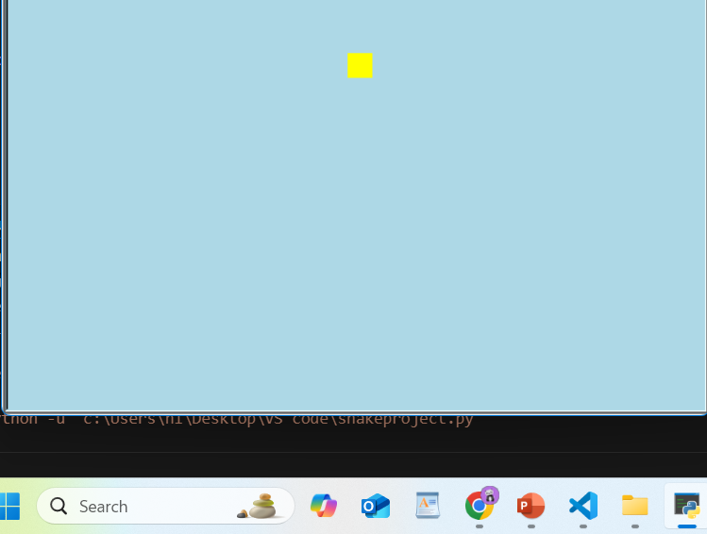
Each Module / Component of the Solution
SNAKE HEAD:

Slide 12
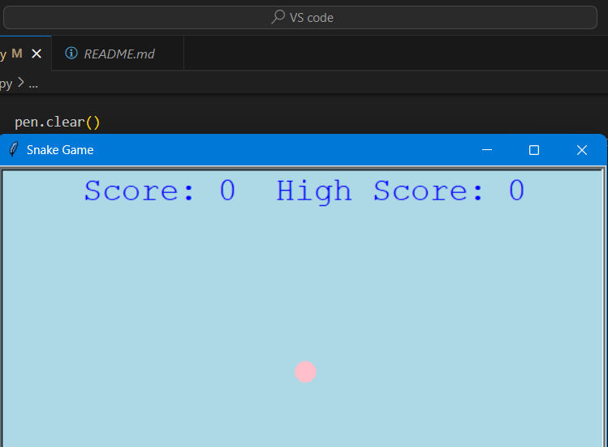
Each Module / Component of the Solution
SNAKE FOOD

Slide 13
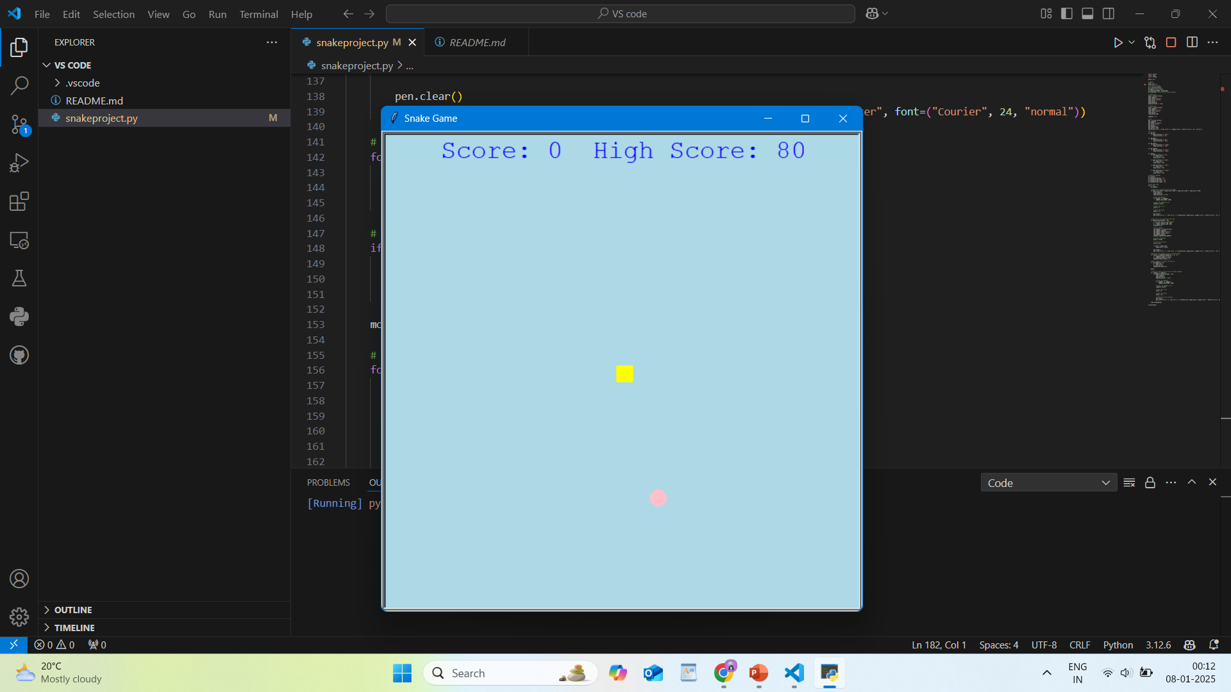
Demo - Solution

Slide 14
Future Expansion / Application
1. Game Window Setup: A window is created using the turtle.Screen() method with a blue background and dimensions of 600x600 pixels. The wn.tracer(0) ensures smoother animation by controlling the update rate of the screen. 2. Snake (Head) Initialization: The snake's head is created using turtle.Turtle(). It is set as a yellow square and initially positioned at the center of the screen (0, 0). The direction is initialized as "Stop," indicating the snake starts in a neutral state. 3. Food Initialization: The food is represented by a circle and is represented by pink color. It is initially placed at (0, 100).

Slide 15
Future Expansion / Application
4. Score and High Score Display: A pen turtle is used to display the current score and the high score at the top of the window. The score updates as the snake eats food, and the high score is recorded if the player beats their previous best. 5. Movement Controls: The game listens for keypresses (W, A, S, D) to control the snake's movement: - W moves the snake up. - S moves the snake down. - A moves the snake left. - D moves the snake right.

Slide 16
Future Expansion / Application
6. Snake Body Segments: When the snake eats food, a new segment is added to its body, and its length increases. The snake's body is managed by the segments list, which stores each segment as a turtle.Turtle() object. 7. Game Logic: The game continuously checks whether the snake collides with the food, the walls, or its own body: - Food Collision: When the snake's head touches the food, a new segment is added, the food moves to a random position, and the score increases. - Wall Collision: If the snake hits the boundary of the screen, the game resets the snake to the center with a "Stop" direction, and the score is reset to 0.

Slide 17
Future Expansion / Application
- Self-Collision: If the snake's head touches any part of its body, the game resets similarly, and the score is reset. 8. Game Reset: If the snake collides with the walls or itself, the game pauses for a short time (using time.sleep(1)), clears the segments, resets the score, and updates the displayed score and high score. 9. Speed Control: The game speed is controlled using a delay, which is adjusted every time the snake eats food. The more the snake eats, the faster the game becomes.

Slide 18
Application
1. Learning Game Development: Provides a basic foundation for understanding how to create 2D games, manage user input, and implement game loops. 2. Introduction to Python Programming: A beginner-friendly project that teaches key Python concepts such as loops, conditionals, and data structures (e.g., lists). 3. Real-Time User Interaction: Demonstrates how to handle real- time user input (keyboard events) and update game elements accordingly.

Slide 19
Application
4. Graphics and Animation: Introduces graphics handling and animation in Python using the turtle library, which is helpful for visualizing game development concepts. 5. Event-Driven Programming: Uses event-driven programming to manage keyboard inputs, allowing for real-time interaction and control over the snake. 6. Collision Detection: Teaches basic collision detection techniques, including handling the snake's interactions with the boundaries and itself.

Slide 20
Conclusion
1. User Input Handling: The game effectively handles keyboard inputs to control the snake’s movement, teaching real-time interaction. 2. Game Logic: The code implements fundamental game logic, including collision detection (for food, walls, and self), scoring, and the game reset mechanism. 3. Animation and Graphics: By utilizing the turtle module, the code provides an understanding of how graphical elements (like the snake and food) can be managed and animated in a game environment.

Slide 21
THANK YOU
Github:

Slide 22
Q & A

